Slide 1

PGL Caythorpe Court Residential Trip

Slide 2

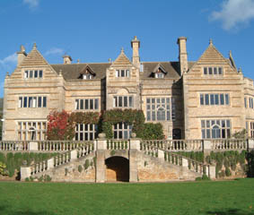
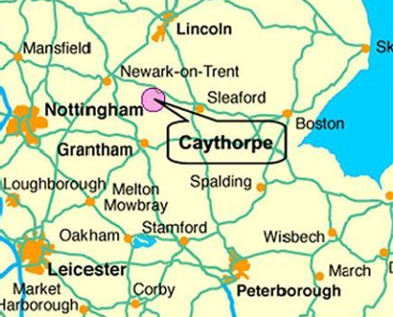
About PGL Caythorpe Court
65 acres of beautiful countryside.
Grade II listed manor house.
Specialist in school residentials.
Safe, fun, and memorable experiences.

Slide 3
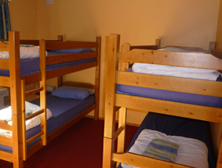
Accommodation
Dormitory rooms (3–8 pupils).
Pupils identify who they’d like (and not like) to be with.
Boys and girls separate.
Staff rooms nearby.
24/7 supervision and support.

Slide 4
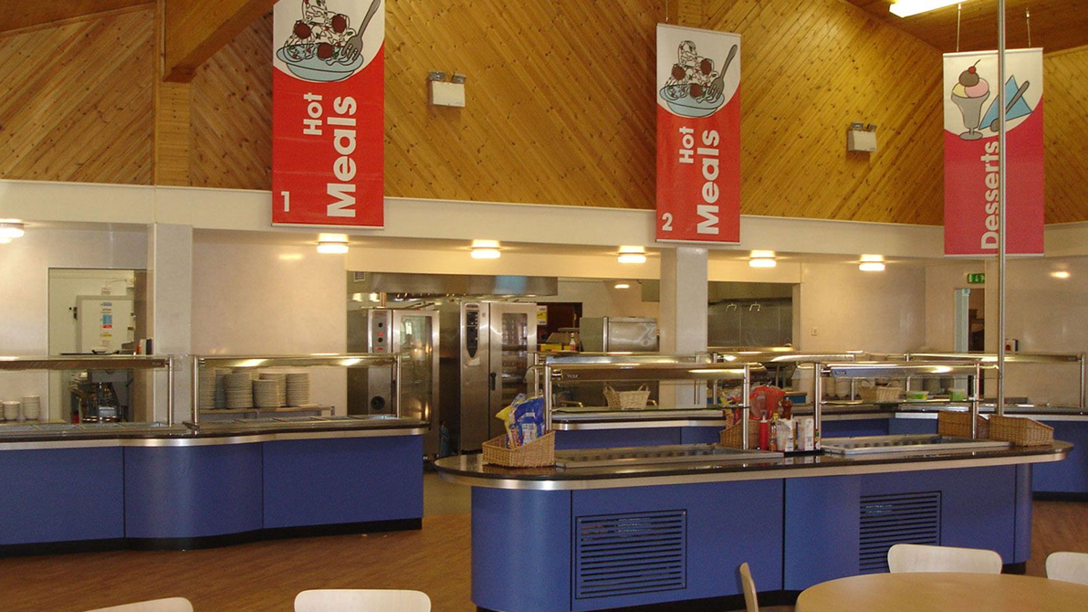
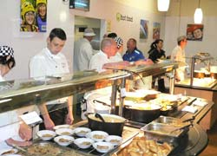
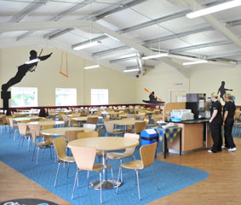
Food and Catering
Nutritious, child‑friendly meals.
Vegetarian, vegan & allergy options.
Buffet style with plenty of choice.
Hydration encouraged.

Slide 5

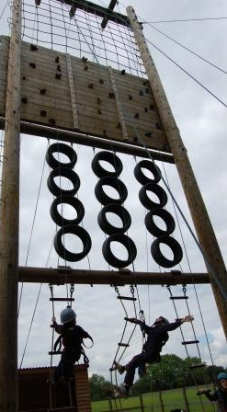
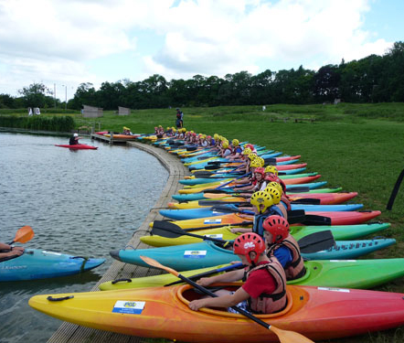
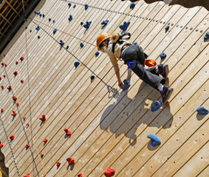
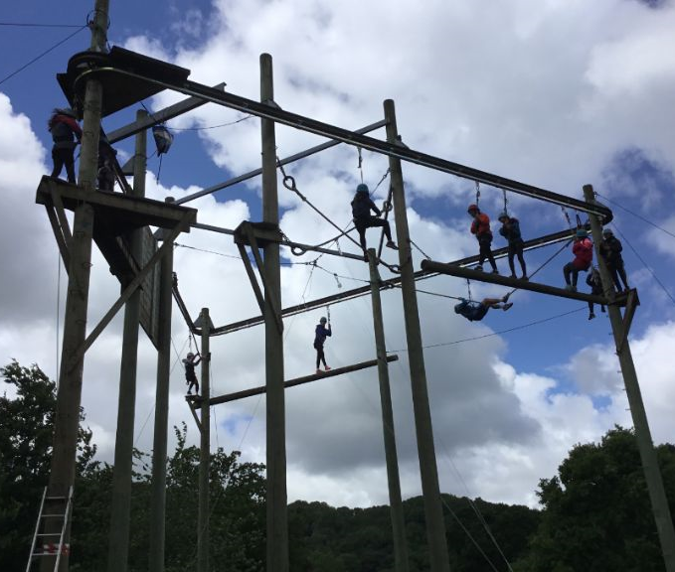
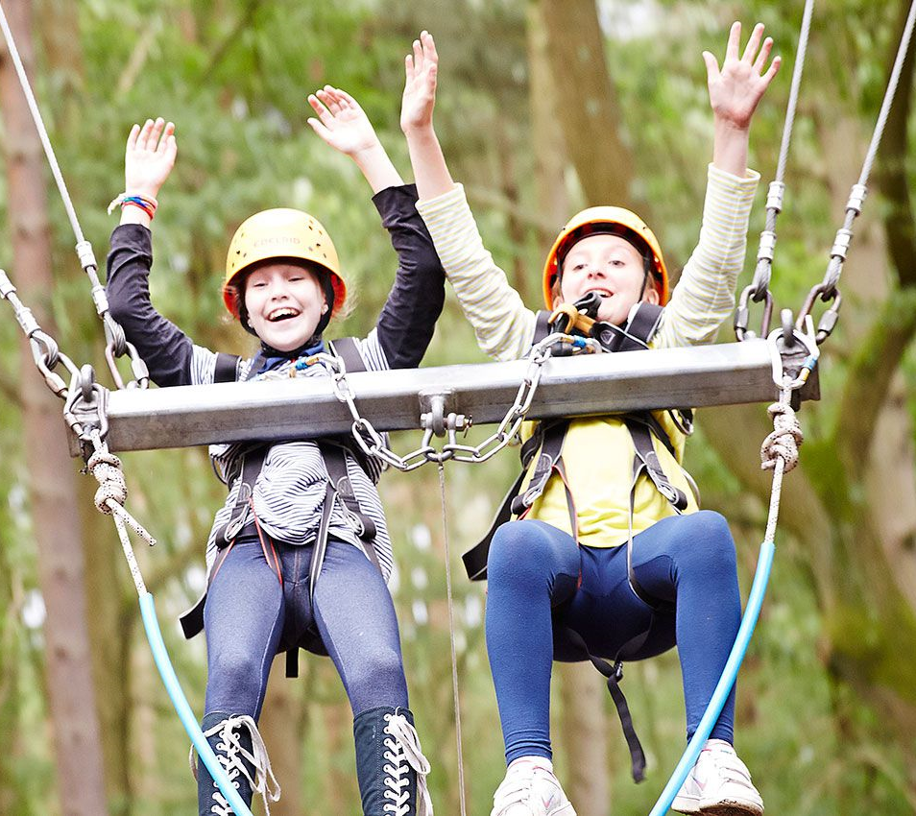
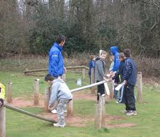
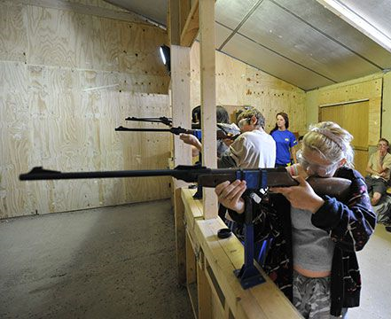
Activities
 | Kayaking | Abseiling | High Ropes
Vertical Challenge | Giant Swing | Problem Solving | Rifle Shooting
Notes:
Individual and team challenges
Encourage new skills and develop existing ones.
Challenge by choice.
Training for each activity first.

Slide 6
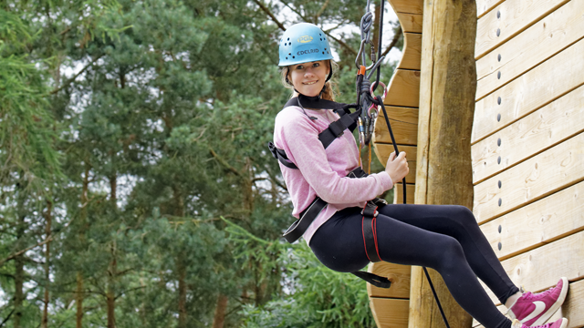
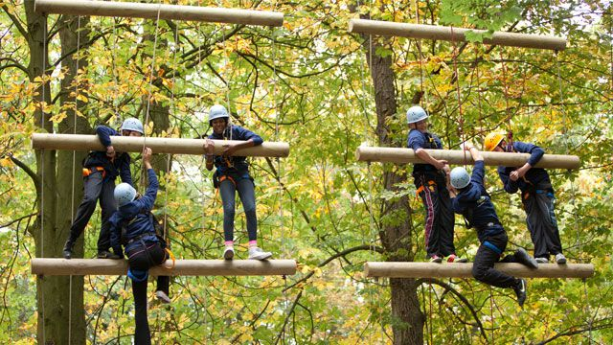
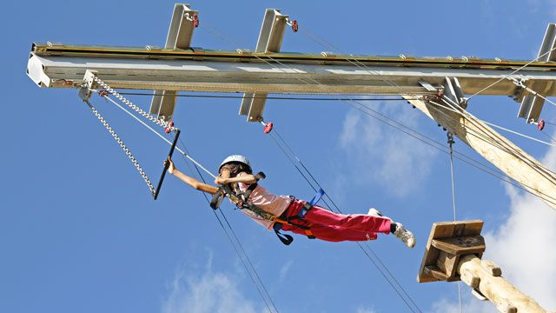
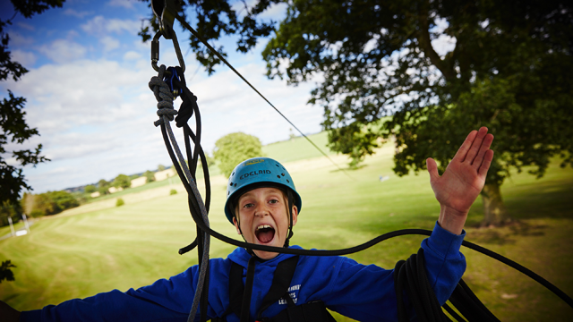
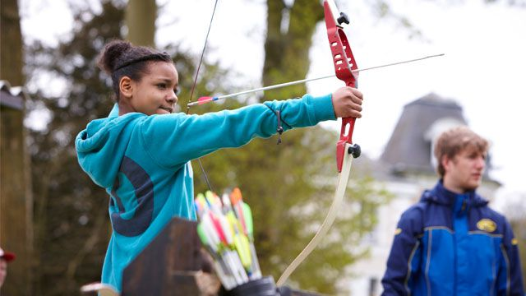
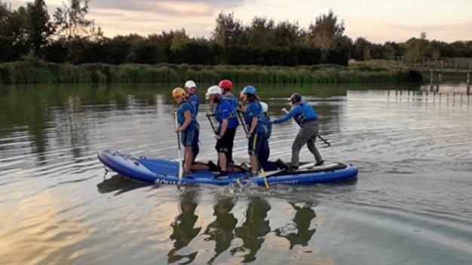
Activities
Abseiling
Jacobs Ladder
Trapeze
Zip Wire
Archery
Paddle Boarding
Notes:
Just some of the activities the children will be taking part in!

Slide 7

Schedule
Wednesday | Thursday | Friday
 | Breakfast | Breakfast
 | Activity 2 | Activity 6
Arrival | Activity 3 | Activity 7
Lunch | Lunch | Lunch
Activity 1 | Activity 4 | Departure
 | Activity 5
Dinner | Dinner
Evening activity | Evening activity
Notes:
4 x 1hr30m activities per day
Activities have been chosen to meet the needs of the group.
Improve self-confidence, team building skills, peer relationships
Raised self esteem
Increased motivation & independence
Evening activities are also hosted by PGL staff and could include games, puzzles and quizzes.

Slide 8
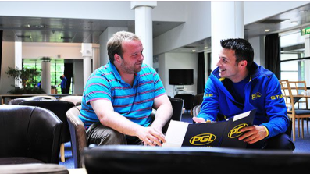
Safety and Supervision
Qualified PGL instructors lead activities.
School staff always present.
Full risk assessments completed.
First aiders on site.
24‑hour security and safeguarding.

Slide 9
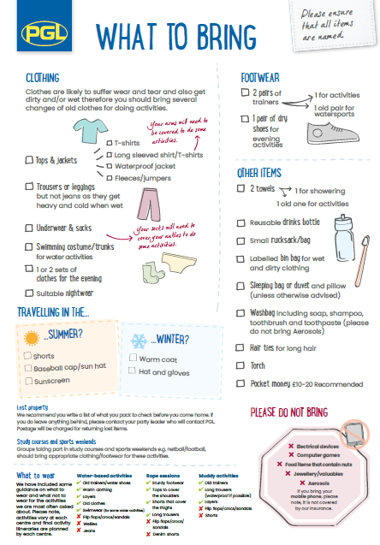
What to pack
Old clothes for outdoor activities.
Waterproof jacket & sturdy footwear.
Sleeping bag/bedding.
Toiletries & towel.
No electronics or valuables.
Full kit list.

Slide 10
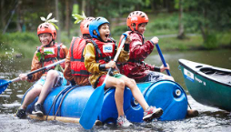
Communication
Emergency contact via school office.
Arrival and departure updates via email.
No mobile phones for pupils.

Slide 11
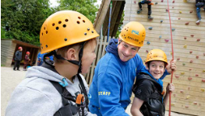
Costs & Payments
Total cost: approximately £325 per child.
Includes: travel, accommodation, meals, activities, insurance.
Payment schedule:
Tuesday, 30th September = £100
Tuesday, 31st March = remainder of the balance
These payments can be paid in monthly instalments via School Money.

Slide 12
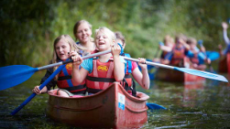
Benefits
Builds independence & resilience.
Encourages teamwork & problem‑solving.
Strengthens friendships.
Creates lasting Year 6 memories.

