Slide 1

KS2 SATS Information Meeting

Slide 2
What will be assessed within the KS2 SATS?
There are KS2 SATS (Standard Assessment Tests) in, English grammar, punctuation and spelling, English reading and mathematics.
In England, SATs are national curriculum assessments that measure a primary school student's progress and attainment in core subjects. They help identify if a child is meeting the age-related expectations set out in the national curriculum.

Slide 3

End of KS2 expectations
There are no KS2 SATS for English writing or Science – these will be assessed via teacher assessment judgements and will be reported to you in your child’s end of year report.

Slide 4
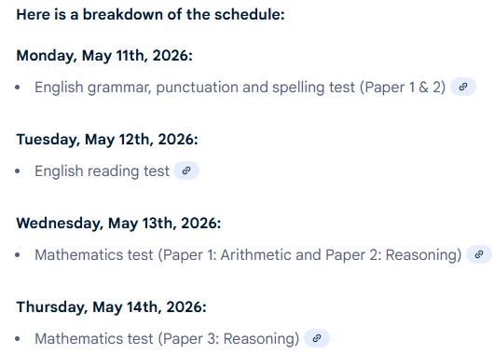
When are the ks2 sats?

Slide 5
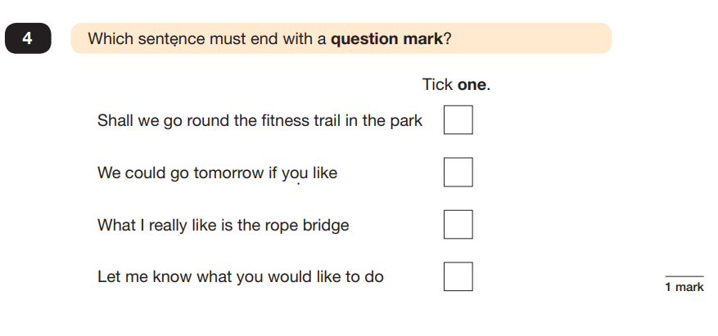
English grammar, punctuation and spelling papers
English grammar, punctuation and spelling Paper 1 – Questions
  50 marks
Spelling Paper 2 – Spelling
  20 marks
Notes:
In Paper 1 the questions are under each short section of text, whilst in Paper 2 the text is in a separate booklet to the questions.
The texts cover a range of poetry, fiction and non-fiction.
Questions are designed to assess the comprehension and understanding of a children’s reading.
Some questions are multiple choice or selected response, others require short answers and some require an extended response or explanation.
The children must read these independently.

Slide 6
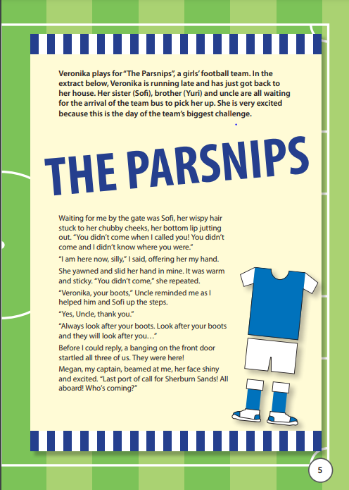
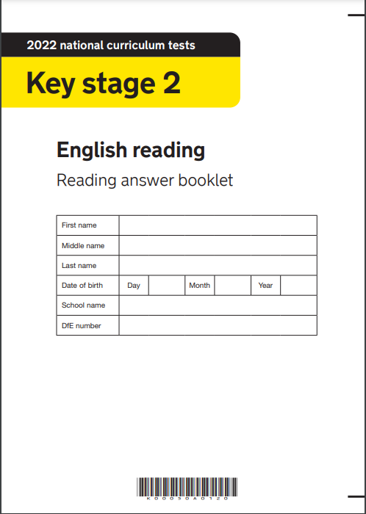
English Reading Paper
English Reading Paper 3
Reading booklet, and answer booklet
  50 marks

Slide 7
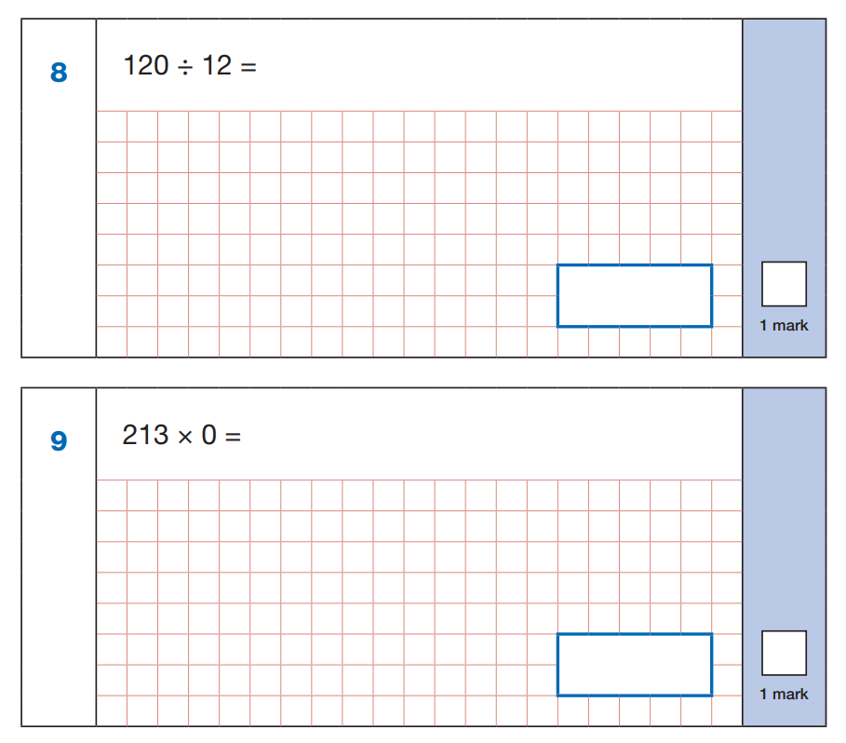
Mathematics papers
Maths Paper 1 – Arithmetic
  40 marks
  30 minutes
Maths Paper 2 – Reasoning
  35 marks
  40 minutes
Maths Paper 3 – Reasoning
  35 marks
  40 minutes
Notes:
Paper 1 covers calculation methods for all operations. No resources can be used. E.g. no number square, number line, etc.
Paper 2 covers problem solving ,reasoning and mathematical fluency. The only resource the children can use is a 30cm ruler.
The questions will be varied. They will be: multiple choice, matching, true/false, completing a chart or table or drawing a shape.
Some questions will also require children to show or explain their working out.

Slide 8

Access arrangements
SATs access arrangements are agreed adjustments, such as using a reader, scribe, or enlarged print, made before a test to ensure candidates with Special Educational Needs and Disabilities (SEND), temporary injuries, or who are English as a second language, are not disadvantaged. The arrangements must be based on normal classroom practice and should not alter the demands of the test or change the answers, which must be the pupil's own.
Notes:
Paper 1 covers calculation methods for all operations. No resources can be used. E.g. no number square, number line, etc.
Paper 2 covers problem solving ,reasoning and mathematical fluency. The only resource the children can use is a 30cm ruler.
The questions will be varied. They will be: multiple choice, matching, true/false, completing a chart or table or drawing a shape.
Some questions will also require children to show or explain their working out.

Slide 9
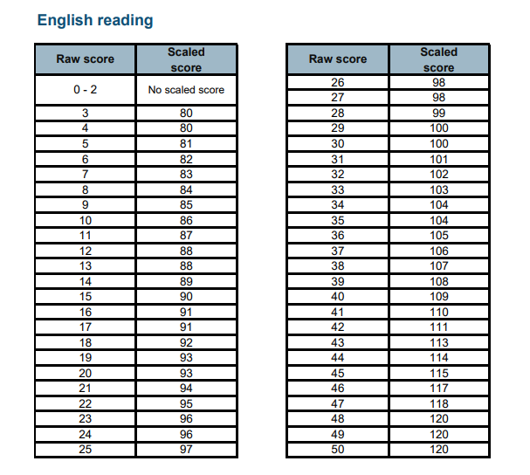
Scaled Scores
Your child will have their paper marked which will show as a ‘raw score’. This will then be converted to a scaled score which will determine whether your child is working at the expected standard.
Your child may have a raw score of 27/50 which is over half marks and achieve less than 100 on the scaled score which would be assessed as ‘Working towards the Expected Standard’.

Slide 10
End of KS2 Assessments
These statements determine whether your child is:
- Working towards the expected standard (WTS) (less than 100)
Working at the expected standard (EXS) (100-109)
Working at greater depth (GDS) (110-120)
Notes:
In Science there is no GDS.

Slide 11
Challenge weeks
Once a term, your child will sit a practice SATS week, in test conditions, so that they feel ready and prepared for May.
Challenge Weeks provide a baseline score, so that we can support your child in achieving their targets by the end of the year. It helps to determine which areas to focus on during lessons and assign any intervention that is needed.

Slide 12
How to help at home…
Ensure your child has the best possible attendance at school.
Make sure your child has a good sleep and healthy breakfast every morning!
During SATs week, we will have a breakfast station set up for when the children first come in, so they get a good start to their day and are ready.

Slide 13
How to help at home…
Homework
Ensure your child completes all homework tasks.
Spellings
Times Tables (we should know all times tables, including divisibility facts, up to 12 x 12)
Maths Homework
Daily Independent Reading (25 mins)

Slide 14
If you have any questions, please feel free to ask, or visit the gov.uk website for more information on KS2 sats.

