Slide 1
Multiplication Tables Check
Year 4 2025-2026

Slide 2
What is the MTC?
The Multiplication Tables Check (MTC) is a statutory assessment for all Year 4 children.
Under the National Curriculum, all primary school children are expected to know their 12 times tables by the end of Year 4.
The purpose of the check is to determine whether pupils can fluently recall their times tables up to 12, which is essential for future success in mathematics.
We have been preparing your child to know their times tables by the end of Year 4 since they began learning about multiplication in Year 1 to Year 2.
We will share your child’s score with you, as we would with all national curriculum assessments. There is no pass or fail mark. We will use the results to identify pupils who may need additional support to learn their times tables.

Slide 3
The Practicalities
The MTC will take place during a 2-week period during June 2026.
The MTC is a digital, on-screen check consisting of 25 times tables questions.
It is completed on a tablet or a computer. Your child will complete their MTC on one of the school’s iPads.
Your child will answer 3 practice questions before beginning the actual check.
Your child will have 6 seconds to answer each question.
The check should take no longer than 5 minutes to complete.
There is no problem solving or division just simple “3 x 4 = ?” type questions.

Slide 4
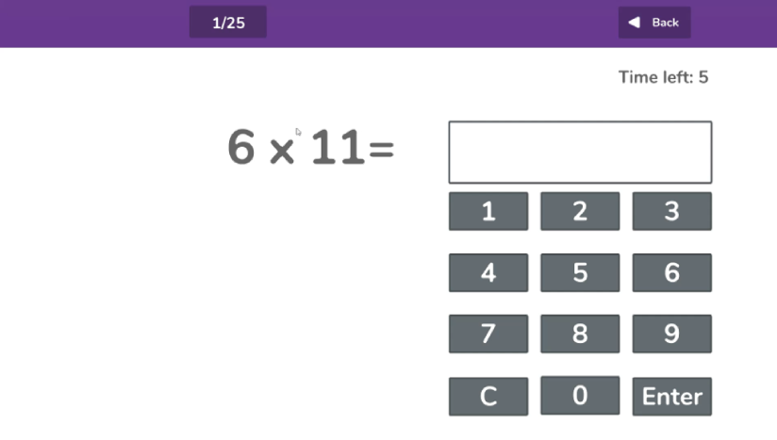
An Example of a MTC Question

Slide 5
Support
There are several accessibility features available in MTC to assist children with special educational needs and disabilities or pupils with English as an additional language (EAL).
We will try these out with your child, should they require support, to ensure they are appropriate, prior to the check in June 2026.
We appreciate that there are some circumstances in which it may not be appropriate for your child to take the check.
If you have any concerns about your child being able to access the MTC, please let Miss Paine or Mrs Allen know.

Slide 6
How to help your child
The Government have called the MTC a ‘check’ rather than a ‘test’ or an ‘exam’ for a reason.
We will of course continue to teach the full curriculum and would love your continued support to help practise the times tables with your child.
Some easy ways to do this include:
  Asking questions such as “What’s 7 x 8?”
  Recalling times tables by rote. “4 times 1 is 4, 4 times 2 is 8, etc.)
  Singing times tables songs. There are a wide variety available online.
  Using a variety of apps and games, such as Times Tables Rock Stars. However, there are a wide variety are available online (hit the button)

Slide 7

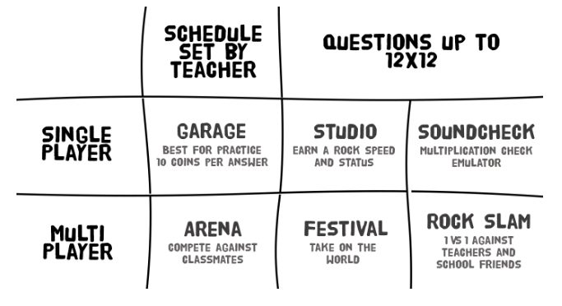
Times Tables Rock Stars
We have subscribed to ‘Times Tables Rock Stars’ (TTRS) again this year.
Your child has access to TTRS. Your child’s TTRS username and password can be found inside of the front cover of their Reading Record.
TTRS has motivating games that will help your child fluently recall their times tables up to 12.
Please be mindful that your child is still learning their times tables.

Slide 8
Any questions?
If you have any questions about the MTC, please take a look at the government publication, ‘Information for parents: multiplication tables check’.
If you have any further questions about the MTC after today, then please email the school office.

Slide 9
Thank you for your continued support
☺

