Slide 1


Baston CE Primary
Tuesday 5th May – Wednesday 6th May 2026

Slide 2
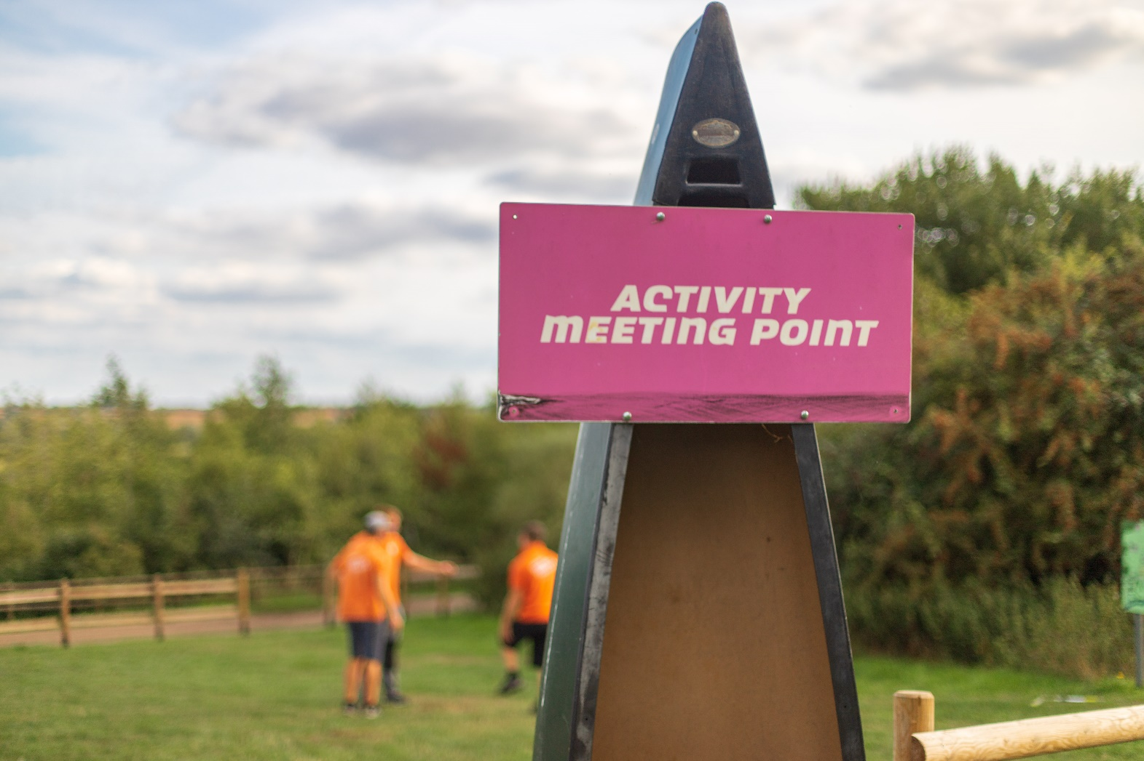
Your adventure starts here!

Slide 3
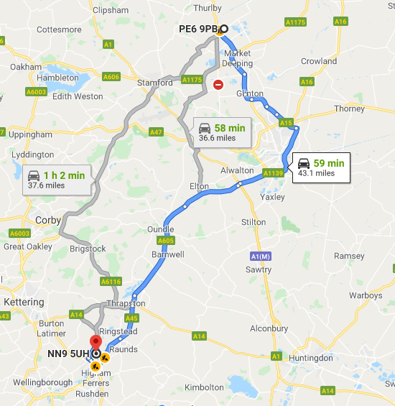
Where are we going?
ROCK UK
Frontier Centre
Addington Road
Irthlingborough
Northants
NN9 5UH
Approximately 1 hour – 1 ½ hours bus journey
If your child suffers from travel sickness, please let us know.

Slide 4
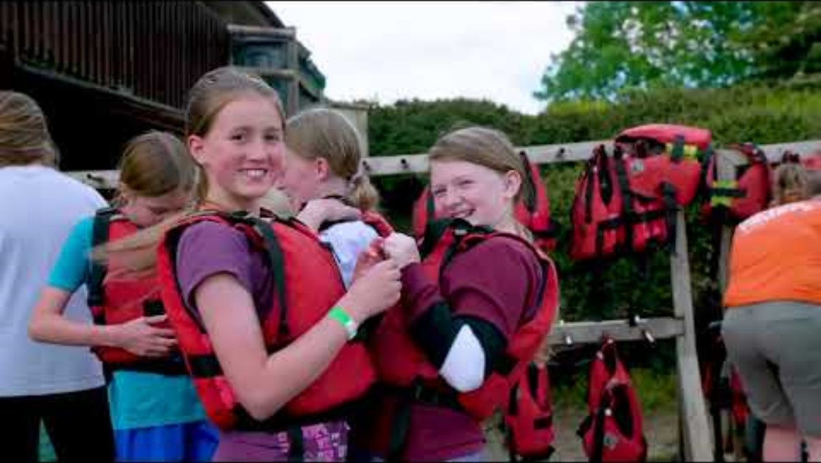
Rock UK The Frontier Centre
https://rockuk.org/centres/frontier-centre/

Slide 5
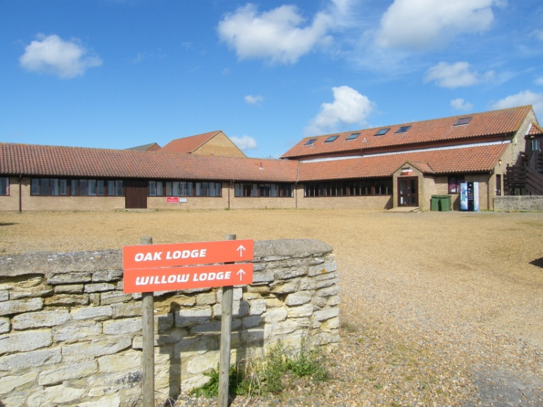
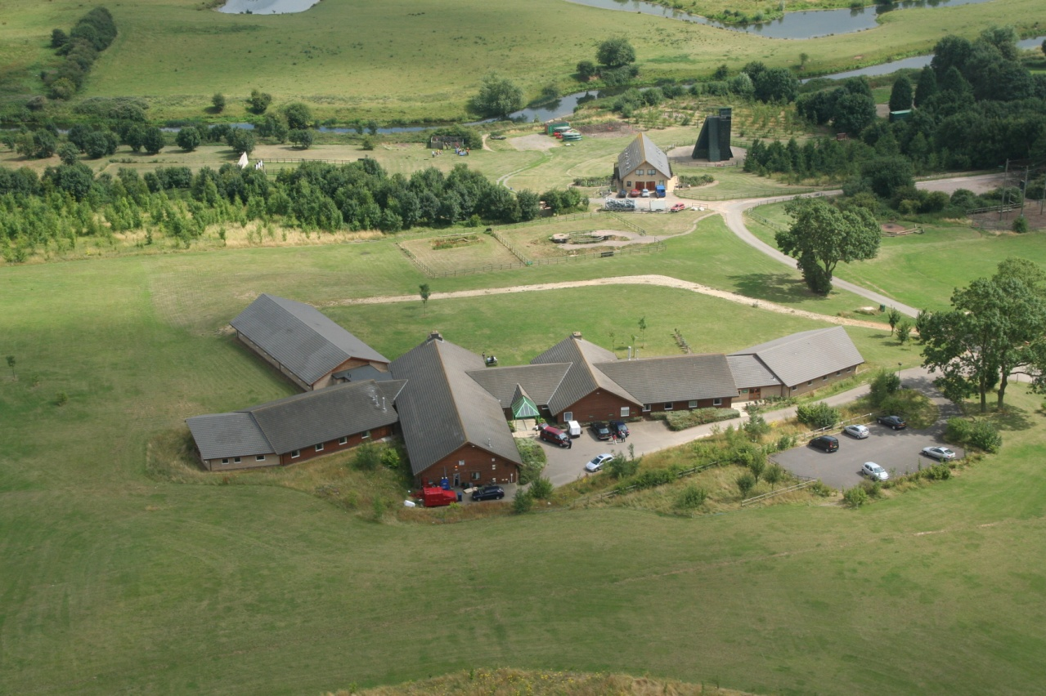
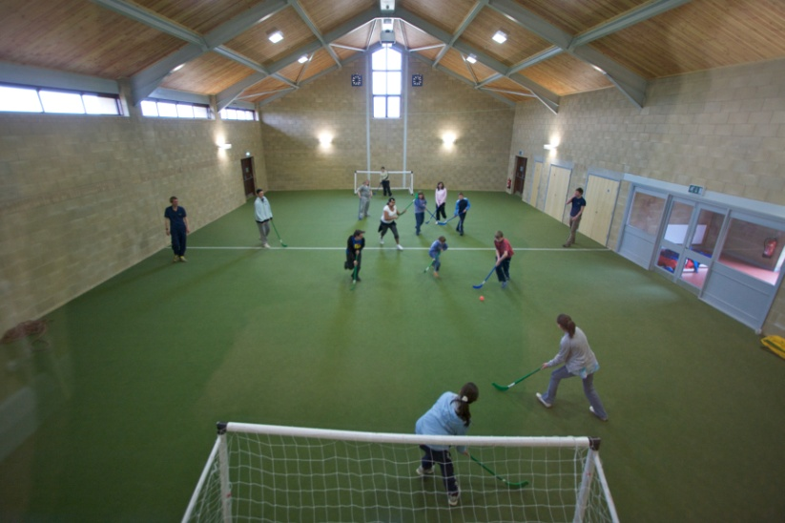
ROCK UK The Frontier Centre
Frontier Centre holds a current Learning Outside the Classroom (LOTC) badge which is an industry kite mark held by quality activity centre’s for quality.
Frontier Centre also hold an AALA certificate which shows that they adhere to Health and Safety standards and have passed the required inspections.

Slide 6
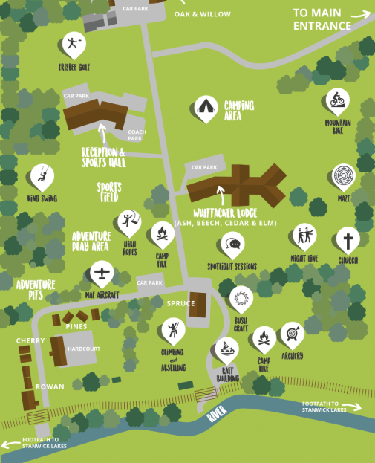
Rock UK The Frontier Centre
We will be staying in the Ash lodge
Please do take a look at the website to find out more.
https://rockuk.org/centres/frontier-centre/

Slide 7
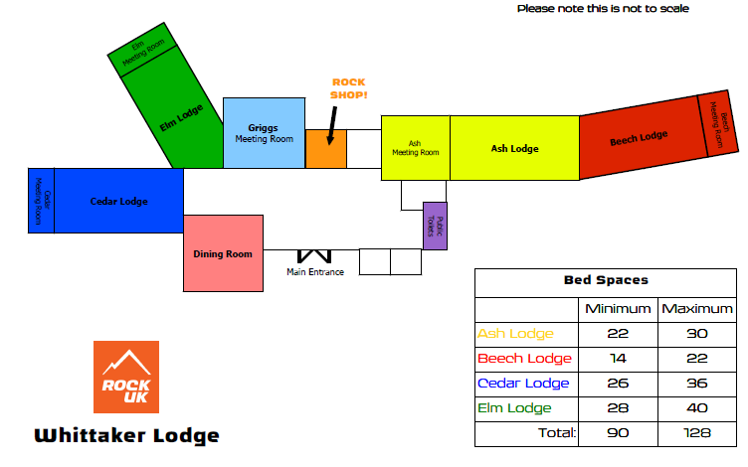
Rock UK The Frontier Centre

Slide 8
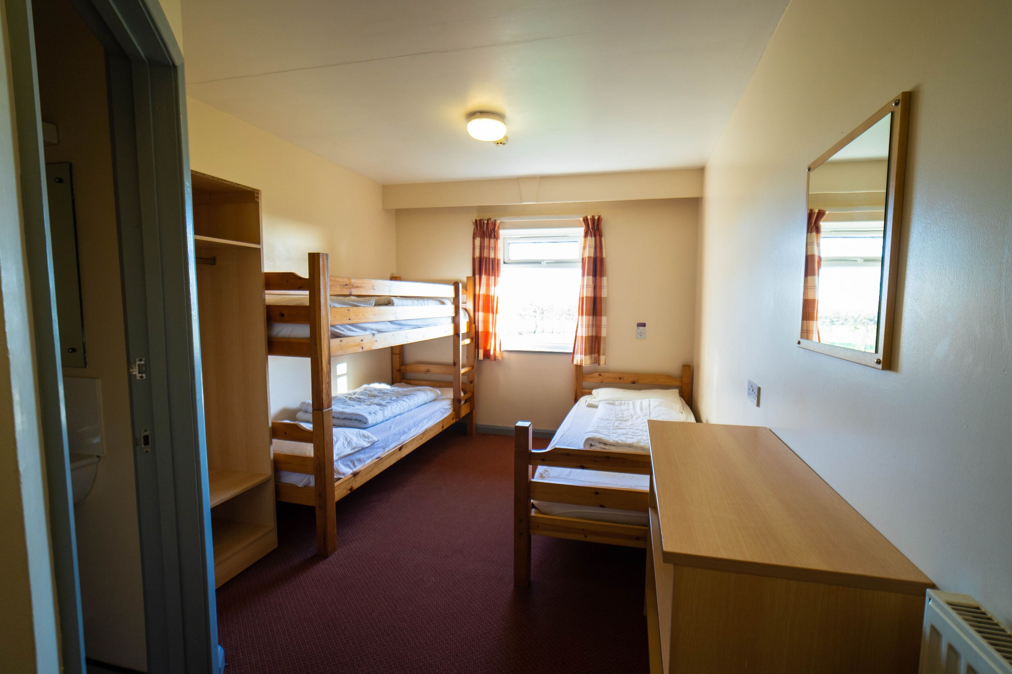
The Bedrooms
Separate bedrooms for boys and girls.
Bedrooms of 2, 4 or 5 children.
All bedrooms have an en-suite bathroom.
The children will be asked to make their own beds and keep their bedroom tidy!

Slide 9
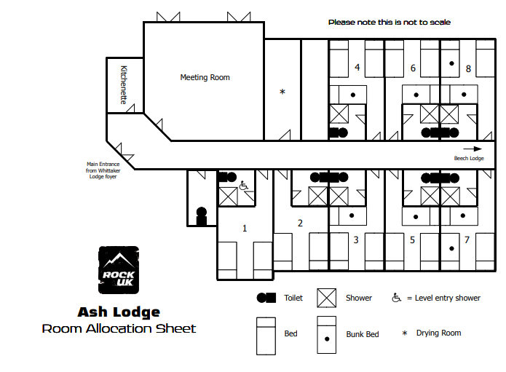
Rock UK The Frontier Centre
We will ask your child to tell us the names of three children that they would like to share a room with.
We will endeavour to ensure your child shares a room with at least one of these children.

Slide 10

Activities
During our time at Rock UK, we will take part in a variety of activities.
These aim to give every child a real taste of adventure whilst teaching important lessons such as:
  leadership skills,
  environmental awareness,
  personal responsibility, and
  teamwork.
You will find more details on the type of activities on the website.

Slide 11
Activities
Activities may include;
• Indoor climbing wall
• Canoeing
• Archery
• Walk the Plank
• Camp fire

Slide 12
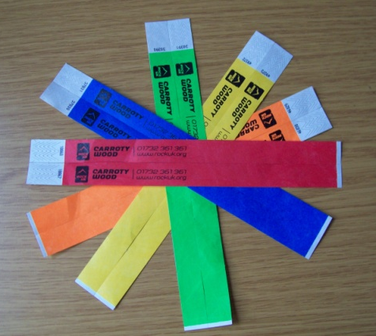

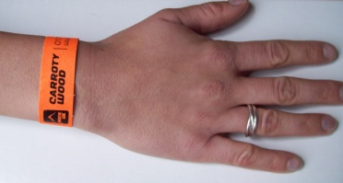
Safety & Security
Every visitor is given a safety welcome talk on arrival.
A member of staff is on duty 24/7 and 25+ staff live on site.
All visitors are given a security wristband.
All members of staff wear a uniform and have a name badge.
All instructors are fully trained and all of the team are DBS checked
Fully fenced site.
Integrated fire alarm systems in place around the site.
All of their centres are licensed by the Adventure Activities Licensing Authority (AALA) and are regularly inspected as part of our internal health and safety audit programme.

Slide 13
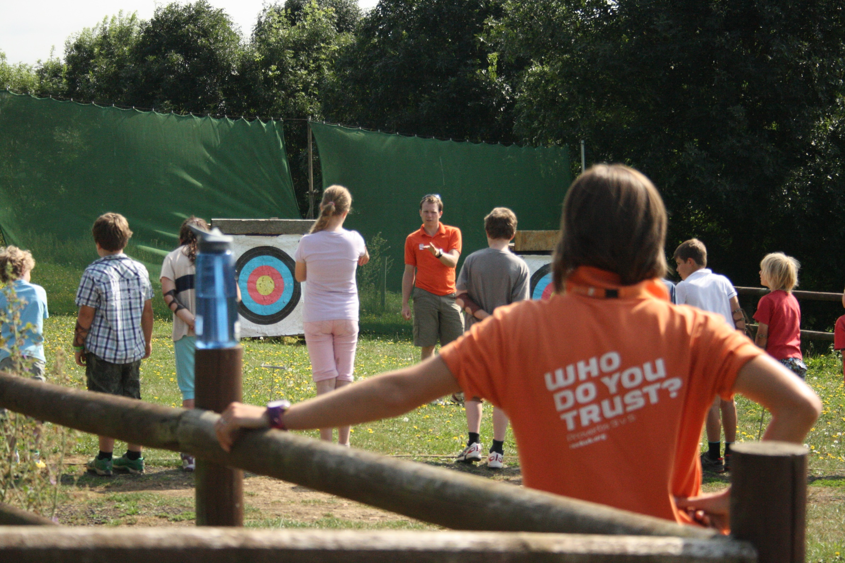
Instructors
Instructors go through ROCK UK’s own in house Instructor training program during which they undergo training and discipleship and work towards nationally required qualification.
The trainees then work alongside the existing instructor team.
ROCK UK believes that the investment in instructors is part of the reason why they have such a good reputation.

Slide 14
Nearer the time…
You will be given:
An ‘Information for Residential Form’ to complete.
This will provide us with additional information that we may need, regarding your child’s dietary requirements, allergies or intolerances, any medication and bedtime requirements.
A kit list
Final arrangements letter with coach costs and details

Slide 15
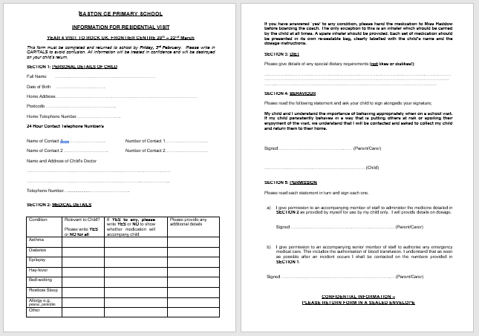
Information for Residential Visit

Slide 16
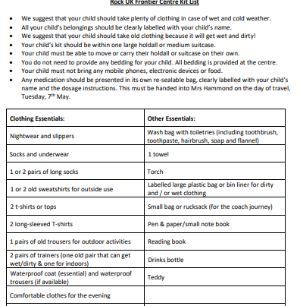
Kit List

Slide 17
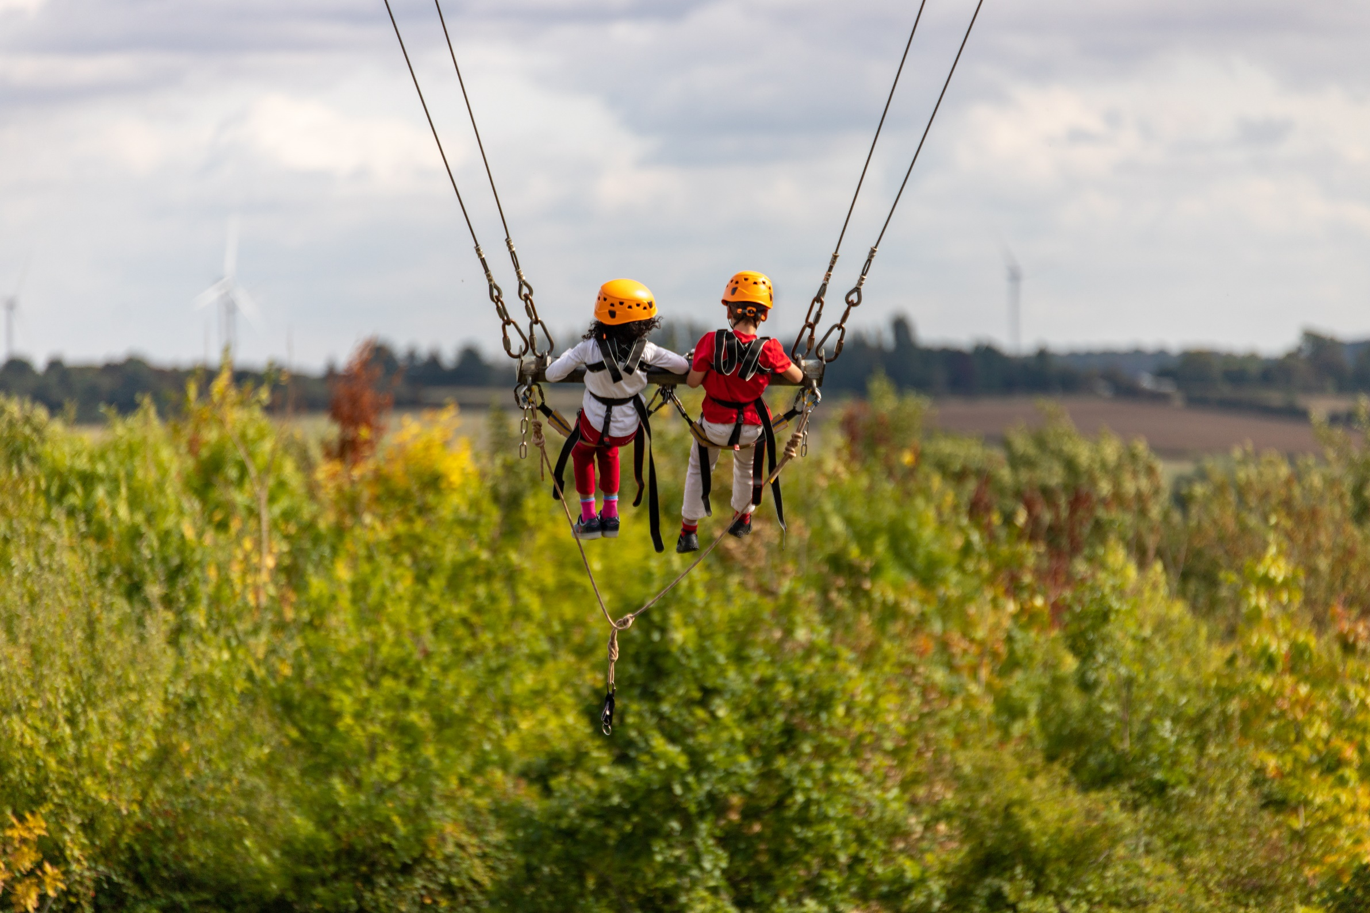
At Rock UK we want to equip every person with a passion and appreciation for their environment. All our instructors have a genuine passion for the outdoors and it’s more than just a job. They encourage high levels of resilience, confidence and independence when tackling challenging activities….
We create memories for life.

Slide 18

Any Questions?

